Slide 1
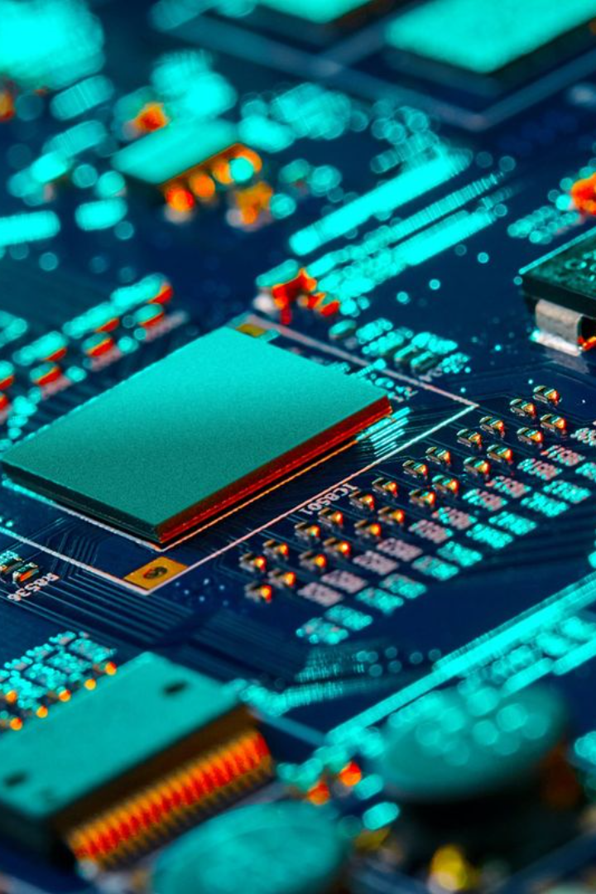
TIC and Technologies Related to TIC
Discover the fascinating world of TIC (Technology, Information, and Communication) and its impact on modern society. Explore its evolution, applications, and future developments.

Slide 2

What is TIC ?
TIC refers to the integration of technology, information, and communication to enhance productivity and facilitate the exchange of information in various fields.

Slide 3

Importance of TIC in Modern Society
Enhanced Communication
Efficient Operations
TIC enables instant communication and information sharing, breaking down geographical barriers and fostering collaboration.
TIC streamlines processes, automates tasks, and improves efficiency, leading to cost savings and increased productivity.
Empowering Individuals
TIC provides access to knowledge, education, and opportunities, empowering individuals and promoting social inclusion.

Slide 4
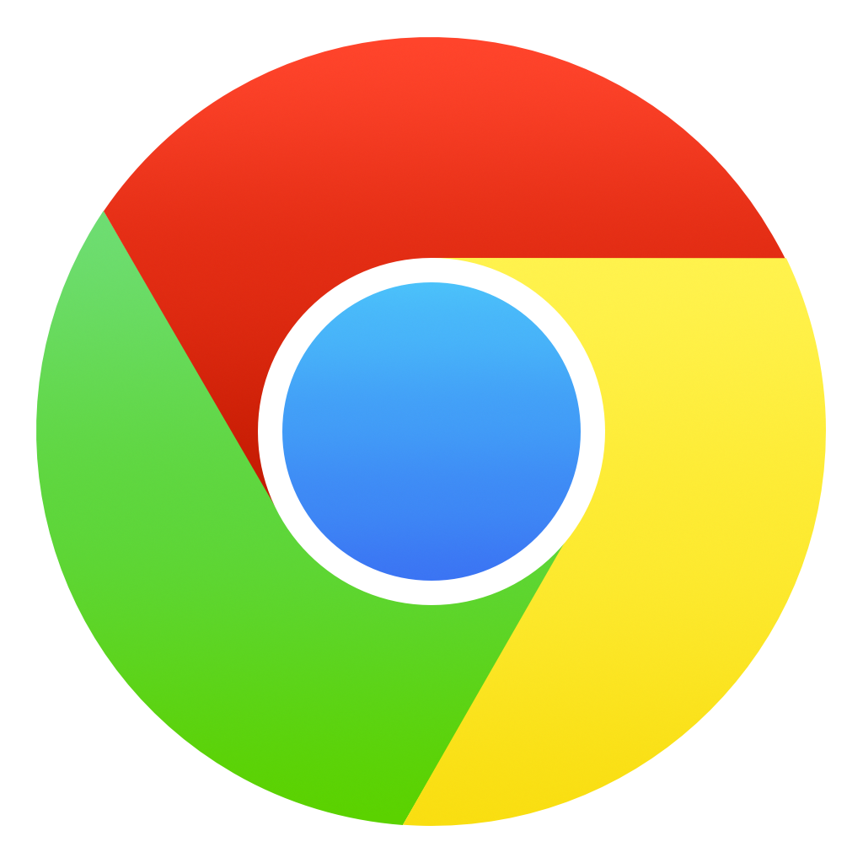
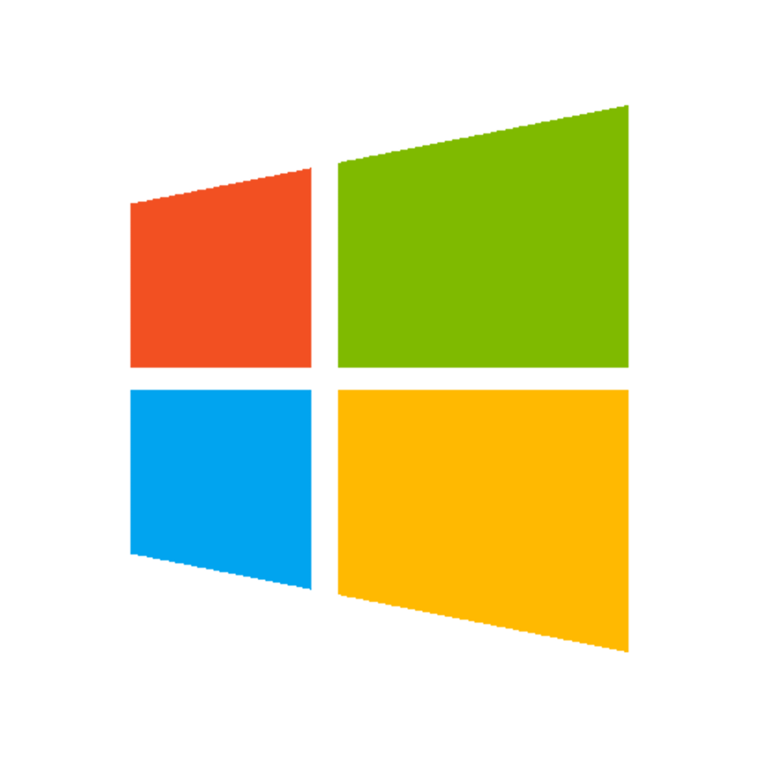
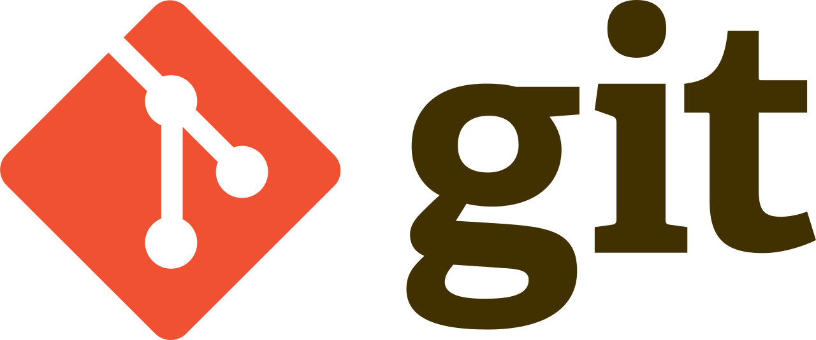
Examples of TIC Applications
Google Services
Microsoft Tools
Google Search, Gmail, Google Drive, and more have revolutionized information access, communication, and collaboration.
Microsoft Office Suite and productivity tools empower individuals and businesses to create, collaborate, and innovate.
Git and GitHub
Git, a distributed version control system, and GitHub, a collaboration platform, enhance software development and foster open-source communities.
This Photo by Unknown author is licensed under CC BY-NC.

Slide 5
Role of TIC in Modern Business
1
Improved Efficiency
2
Enhanced Customer Experience
TIC enables streamlined operations, automation, and data-driven decision-making, leading to increased productivity and competitiveness.
TIC facilitates personalized interactions, personalized marketing, and online services, creating a seamless customer experience.
3
Global Connectivity
4
Innovation and Adaptation
TIC connects businesses with global markets, enabling international collaboration, expansion, and access to new opportunities.
TIC encourages innovation, digital transformation, and the ability to adapt to market changes, driving business growth and success.

Slide 6
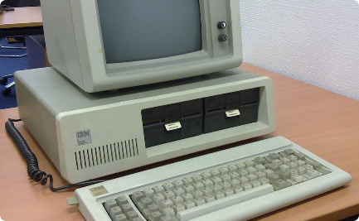
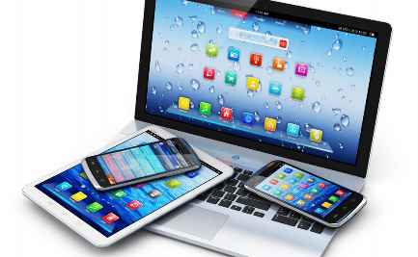
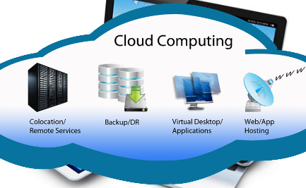
Evolution and Development of TIC
From Mainframes to Personal Computers
Rise of Mobile Devices
The Advancement of Cloud Computing
Explore the impact of smartphones and tablets in making TIC accessible anytime, anywhere, and changing the way we interact with technology.
Witness the evolution of TIC from massive mainframes to compact personal computers that revolutionized access to technology.
Discover how cloud computing has transformed the storage and processing of data, enabling scalability, reliability, and collaboration.

Slide 7
Challenges of Implementing TIC and Solutions
1
Complexity and Integration
TIC implementation can be complex and require integration across systems. Solution: Partner with experienced technology providers.
2
Cybersecurity and Data Privacy
Protecting sensitive data and ensuring privacy pose challenges. Solution: Implement robust security measures and compliance protocols.
3
Skill Gaps and Training
Adopting TIC may require upskilling employees. Solution: Invest in training programs and create a culture of continuous learning.

Slide 8
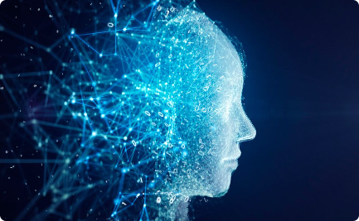
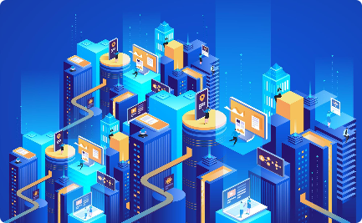
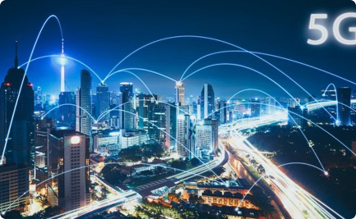
Future Developments in TIC
Artificial Intelligence (AI)
Internet of Things (IoT)
5G Network
Discover the interconnected world of IoT, where devices communicate and share data to enhance efficiency and improve lives.
Unlock the power of ultra-fast, low-latency 5G networks for seamless connectivity, real-time data transfer, and transformative applications.
Experience the potential of AI in transforming industries, automating tasks, and creating personalized experiences.

